Slide 1
Embedded Systems Introduction
Data Acquisition – Basic Operation
Eng. Giacomo Silvagni, Ph.D.
Alma Mater Studiorum – University of Bologna
Department of Industrial Engineering (DIN)

Slide 2
Outline
Electronic Signals
Sensors
Actuators
Serial Communication protocols

Slide 3
Outline
Electronic Signals
  Analog Signal
  Digital Signal
  Basic of Signal Acquisition and processing
Sensors
Actuators
Serial Communication protocols

Slide 4
Data Acquisition – Basic Operation
Electronic Signals
All communication between electronic components are facilitated by electronic signals. There are two main types of electronic signals: analog & digital.
Analog and digital signals use changes in time and amplitude to represent data for transfer and reception. From controlling UAVs for defense applications to sharing information between devices at home, their use has become ambiguous, being used in everything. First, engineers must carefully consider the interconnect solution for these signals to be sent and received correctly.
Signals represent and transfer data based on time (often referred to in terms of frequency) and amplitude. Systems need signal connectors to use the information transmitted by signals, whether those signals represent video, audio, sensor data, or control instructions.

Slide 5
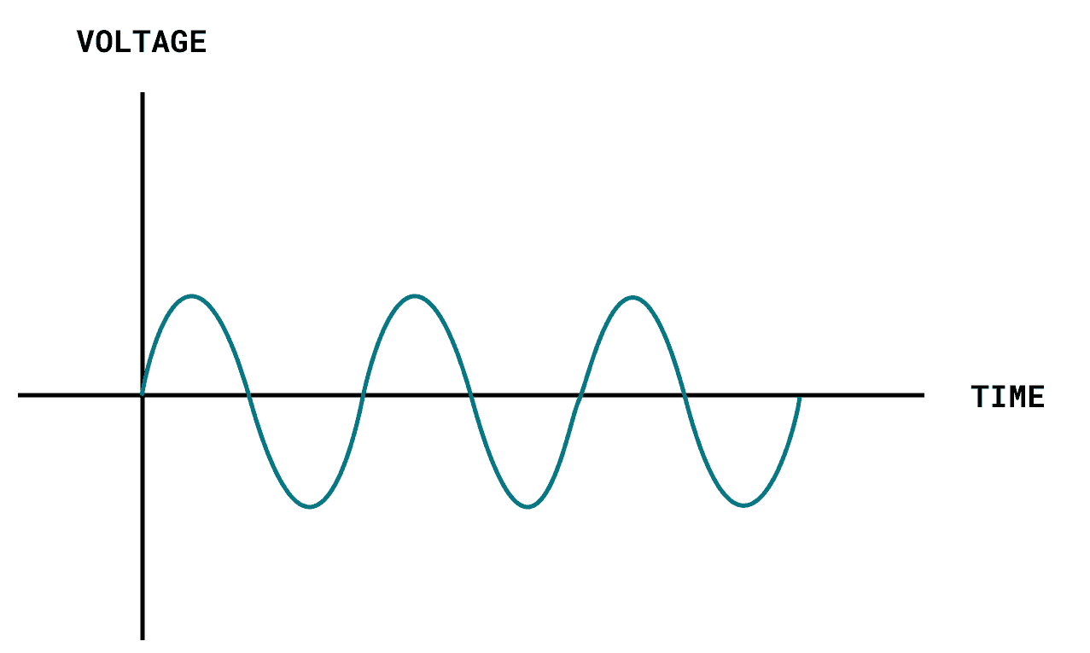
Data Acquisition – Basic Operation
Electronic Signals – Analog signal
An analog signal is a continuous signal in which one time-varying quantity (such as voltage, pressure, etc.) represents another time-based variable. In other words, one variable is an analog of the other. The result is that analog systems allow for a theoretically infinite number of values to be represented: it can achieve any value within the parameters governing the system.
Changes in parameters such as light, sound, temperature, pressure, position, or other physical phenomena generate analog signals. These signals then represent a time-varying quantity (e.g., pressure, change in light) using another time-based variable, such as current or voltage.

Slide 6
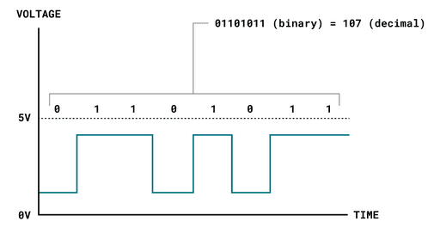
Data Acquisition – Basic Operation
Electronic Signals – Digital signal
Digital signals are non-continuous electrical signals with great flexibility in their use. One unique feature of these signals is the ability to encrypt and compress digital data, making it a secure option for data transfer. As a result, digital signals are used extensively in several industries, including networking and data communications, broadband and cellular communications systems, computing equipment, and data transmission devices.
A digital signal works a bit different, representing only two binary states (0 or 1) that are read as high or low states in the program. This is the most common signal type in modern technology.

Slide 7
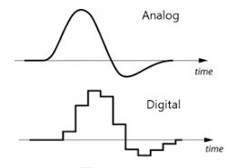
Data Acquisition – Basic Operation
Electronic Signals – Basic of Signal Acquisition and processing
How does an analog signal differ from a digital signal?
An analog signal varies continuously over time, whereas a digital signal represents data as discrete values, usually in binary form (0s and 1s). Analog signals are susceptible to noise and degradation, while digital signals are more resistant to interference.

Slide 8
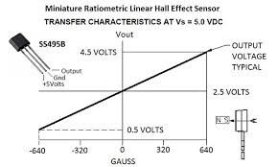
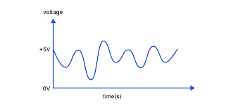
Data Acquisition – Basic Operation
Electronic Signals – Basic of Signal Acquisition and processing
How do analog signals transmit data?
Analog signals transmit data by varying their amplitude, frequency, or phase in response to changes in the measured quantity. For example, in audio transmission, changes in sound pressure are directly represented by variations in the analog signal's voltage.

Slide 9
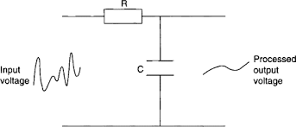
Data Acquisition – Basic Operation
Electronic Signals – Basic of Signal Acquisition and processing
What are the advantages of analog signal processing?
Analog signal processing offers several advantages, including simplicity in design and implementation, lower cost compared to digital processing systems, and the ability to handle real-world phenomena more naturally due to its continuous nature. Analog circuits are often more energy-efficient and can provide faster response times in certain applications. Additionally, analog systems are less susceptible to quantization errors and can sometimes offer higher resolution in certain scenarios.

Slide 10
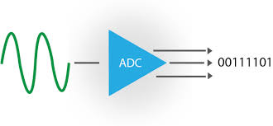
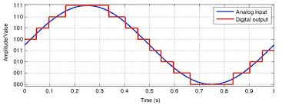
Data Acquisition – Basic Operation
Electronic Signals – Basic of Signal Acquisition and processing
When would I use ADC?
Analog-to-Digital Conversion (ADC) is used when you need to process, store, or transmit analog signals—like sound or light—in a digital format. This conversion is essential in applications such as digital audio recording, where sound waves are converted into digital files, or in digital cameras, where visual images are transformed into digital photos. ADC is also crucial in various scientific measurements and telecommunications, allowing the seamless integration of analog inputs with digital processing and storage systems.

Slide 11
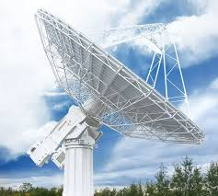
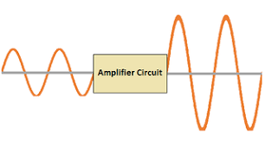
Data Acquisition – Basic Operation
Electronic Signals – Basic of Signal Acquisition and processing
Can analog signals be transmitted over long distances?
Analog signals can be transmitted over long distances, but they're more susceptible to degradation and interference compared to digital signals. To maintain signal integrity over long distances, analog signals often require amplification and filtering.

Slide 12
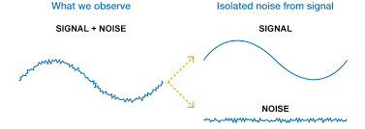
Data Acquisition – Basic Operation
Electronic Signals – Basic of Signal Acquisition and processing
How does noise affect analog signal transmission?
Noise, such as electromagnetic interference or random fluctuations, can distort analog signals during transmission, leading to errors or inaccuracies in the received data. This interference is a significant challenge in analog communication systems.

Slide 13
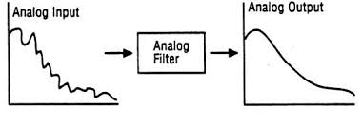
Data Acquisition – Basic Operation
Electronic Signals – Basic of Signal Acquisition and processing
What role does filtering play in analog signal processing?
Filtering in analog signal processing is critical for selectively allowing certain frequencies to pass through while blocking others. This process is essential for eliminating unwanted noise, enhancing signal quality, and isolating specific signal components for further analysis or processing. Filters are used in a wide range of applications, including audio engineering to refine sound quality, telecommunications to separate signal channels, and in electronic devices to smooth power supply currents. Effective filtering ensures clearer communication, improved system performance, and higher quality signal transmission and reception.

Slide 14
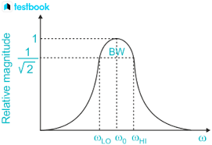
Data Acquisition – Basic Operation
Electronic Signals – Basic of Signal Acquisition and processing
What is the concept of bandwidth in analog signals?
Bandwidth refers to the range of frequencies within an analog signal that can be effectively transmitted or processed. It's a crucial parameter in communication systems, as it determines the amount of data that can be transmitted within a given time frame.

Slide 15
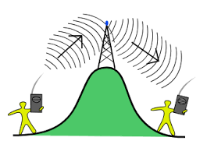
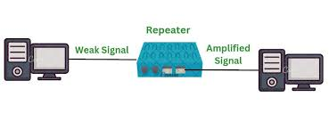
Data Acquisition – Basic Operation
Electronic Signals – Basic of Signal Acquisition and processing
What role do repeaters play in analog signal transmission?
Repeaters play a vital role in analog signal transmission by amplifying weak signals over long distances. As an analog signal travels, it gradually loses strength due to attenuation and interference. Repeaters intercept these weakened signals, amplify them back to their original power level, and retransmit them. This process ensures the signal can cover longer distances without degradation, maintaining communication quality and reliability in networks and telecommunications systems.

Slide 16
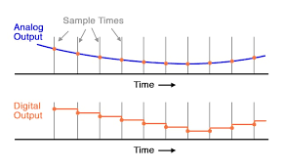
Data Acquisition – Basic Operation
Electronic Signals – Basic of Signal Acquisition and processing
Can analog signals be stored digitally?
Analog signals can be stored digitally through a process called Analog-to-Digital Conversion (ADC). In this process, the continuous analog signal is sampled at regular intervals and converted into a series of digital values representing the signal's amplitude at each point in time. This digital representation can then be stored, processed, and transmitted by digital systems, allowing for efficient and flexible handling of analog data.

Slide 17
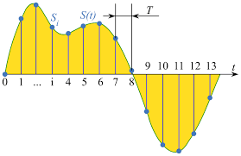
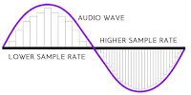
Data Acquisition – Basic Operation
Electronic Signals – Basic of Signal Acquisition and processing
How does the sampling rate affect ADC?
The sampling rate determines how frequently an analog signal is measured and converted into digital form. A higher sampling rate captures more detail from the analog signal but requires more storage and processing resources.

Slide 18
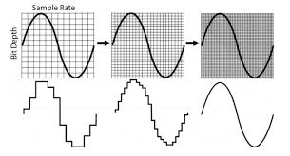
Data Acquisition – Basic Operation
Electronic Signals – Basic of Signal Acquisition and processing
How does the sampling rate affect ADC?
The sampling rate determines how frequently an analog signal is measured and converted into digital form. A higher sampling rate captures more detail from the analog signal but requires more storage and processing resources.

Slide 19
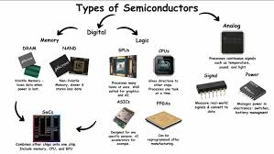
Data Acquisition – Basic Operation
Electronic Signals – Basic of Signal Acquisition and processing
Does analog signal processing require specialized hardware?
Analog signal processing often requires specialized hardware, such as operational amplifiers, resistors, capacitors, and inductors, to manipulate the analog signals directly. This hardware is used to implement various functions like amplification, filtering, and modulation. The design and assembly of these components are tailored to the specific requirements of the analog signal processing task, ensuring precise control over the signal's characteristics and behavior.

Slide 20
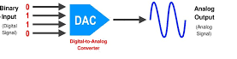
Data Acquisition – Basic Operation
Electronic Signals – Basic of Signal Acquisition and processing
What role does a DAC play in signal processing?
A Digital-to-Analog Converter (DAC) plays a crucial role in signal processing by converting digital data into analog signals. This conversion is essential for interfacing digital systems with the real world, where most inputs and outputs are analog, such as sound, light, and temperature. DACs are vital in applications like audio playback devices, where they convert digital audio files into analog signals that can drive speakers, and in video systems, enabling digital video data to be displayed on analog monitors or TVs.

Slide 21
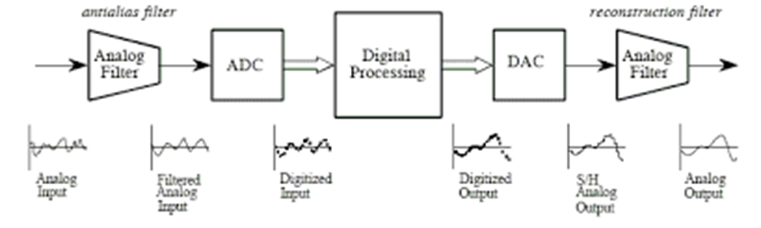
Data Acquisition – Basic Operation
Electronic Signals – Basic of Signal Acquisition and processing
Analog vs Digital Signals
Analog signals represent one continuous variable as the result of another continuous time-based variable. They are capable of outputting continuous information with a theoretically infinite number of possible values.
We have seen analog signals in use in nearly every type of signal processing and consumer electronics application imaginable. In most cases, they have been replaced by digital versions, though analog processes are still common in the audio recording domain alongside digital recording equipment.

Slide 22
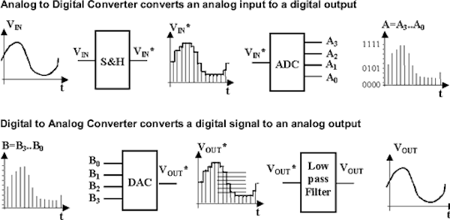

Data Acquisition – Basic Operation
Electronic Signals – Basic of Signal Acquisition and processing
ADC & DAC

Slide 23
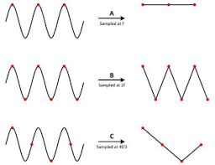
Data Acquisition – Basic Operation
Electronic Signals – Basic of Signal Acquisition and processing
The Nyquist Theorem
When you want to describe a continous signal (analog) with a fixed amount of samples (resolution), you need to select a proper acquisition frequency (Fs) for a good signal reconstruction.
NYQUIST-SHANNON THEOREM : Fs = 2.5 f

Slide 24
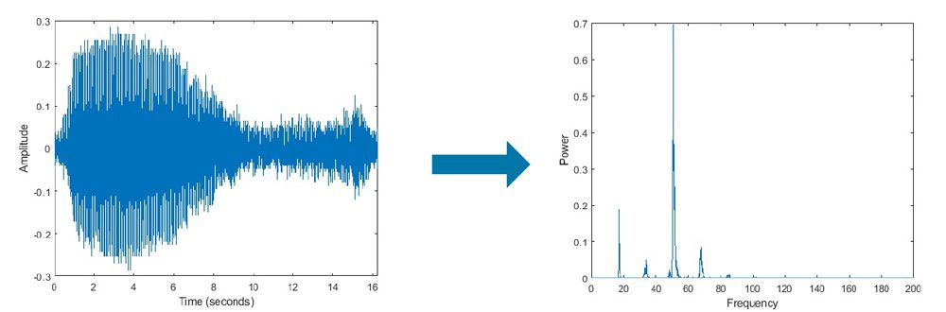
Data Acquisition – Basic Operation
Electronic Signals – Basic of Signal Acquisition and processing
The Nyquist Theorem
The proper way to find out the main frequency (carrier) is to perform a frequency analysis of the physical system and calculate the FFT (fast Fourier Transform)
By looking at the spectrogram (power spectrum) you can easily extract the signal features and define the main carrier (f).
NYQUIST-SHANNON THEOREM : Fs = 2.5 f
FFT

Slide 25
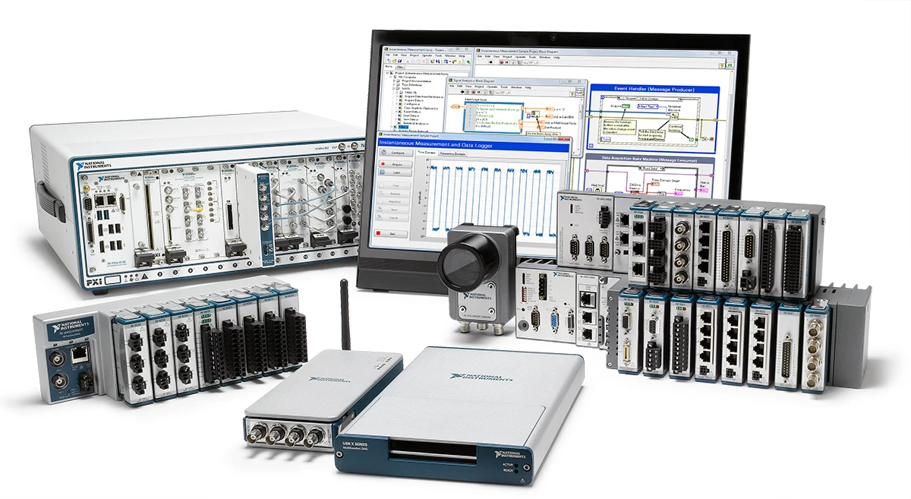
Data Acquisition – Basic Operation
Electronic Signals – Basic of Signal Acquisition and processing
DAQ Systems
Data Aquisition Systems are the most important tools for acquiring signals.
Differnt cost, layout, feature, performance, pinout, channels,…
Fixed or reconfigurable hardware
FPGA for best performance (high cost)

Slide 26
Outline
Electronic Signals
Sensors
Actuators
Serial Communication protocols

Slide 27
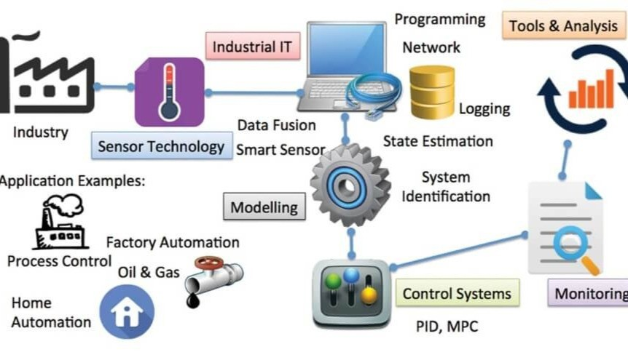
Data Acquisition – Basic Operation
Sensors
When working with Physical systems, it is important to understand sensors and actuators, and the difference between them because they are crucial for controlling and optimizing the industrial process.

Slide 28
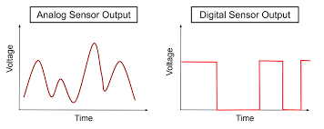
Data Acquisition – Basic Operation
Sensors
What Is a Sensor?
A sensor, in simple terms, is used to sense its environment, meaning it records a physical parameter, for example temperature, and converts it into an electronic signal.
Sensors can also take the form of just a simple button: when a state changes (we pressed a button), the electronic signal is switched from low to high (0 to 1).

Slide 29
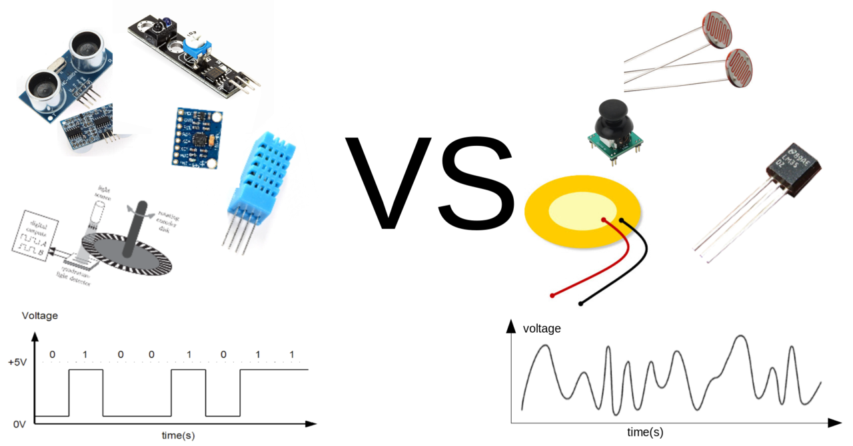
Data Acquisition – Basic Operation
Sensors
What Is a Sensor?
There are many types of sensors, and several ways of recording data from them. Perhaps the easiest to use is an analog sensor, where we communicate a range of values through altering the voltage input fed into an acquisition system.

Slide 30
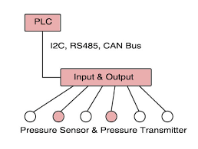
Data Acquisition – Basic Operation
Sensors
What Is a Sensor?
Digital sensors are a bit more advanced, depending on the type. They rely on Serial Communication Protocols to send the data accordingly, and requires a bit more effort to translate the data. As mentioned, data is sent using a binary sequence (e.g. 101101 is 45), and this needs to be addressed and configured on a software level.

Slide 31
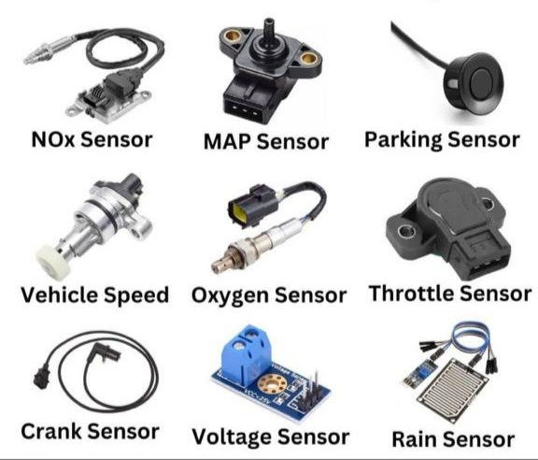
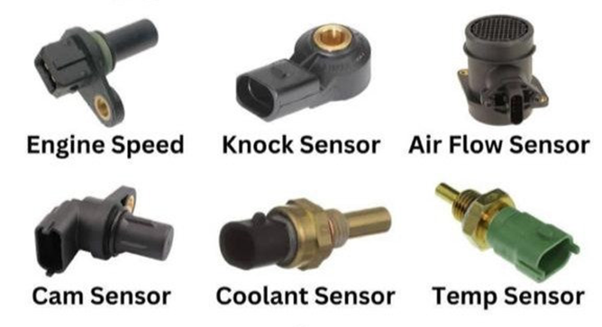
Data Acquisition – Basic Operation
Sensors
Standard Sensors for Industrial applications
  Temperature
  Pressure
  Air Flowrate
  Fluids Flowrate
  Vibration
  Speed
  Torque
  Voltage and Current

Slide 32
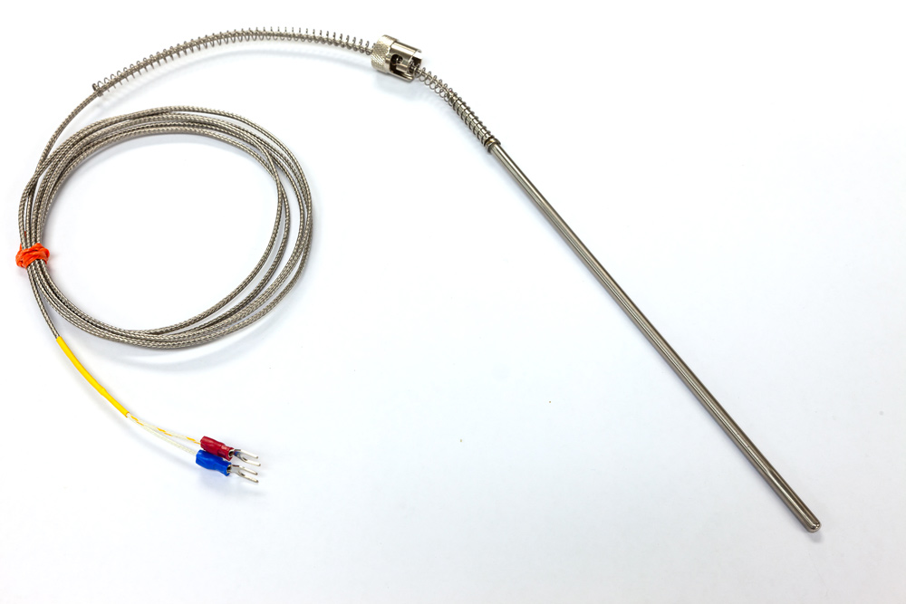
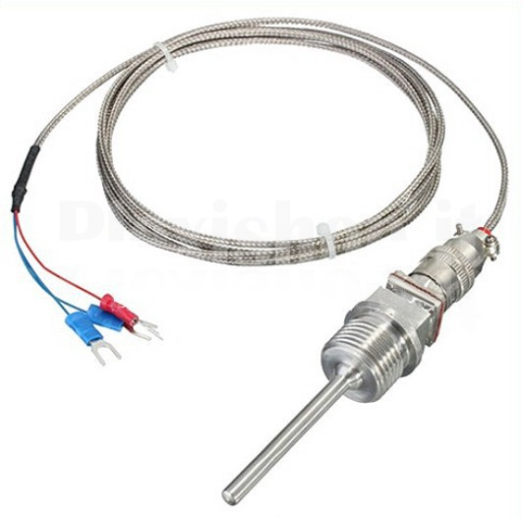
Data Acquisition – Basic Operation
Sensors
Temperature
  Thermocouples
  Thermoresistors
Very similar but extremely different
Thermocouple
Thermoresistors

Slide 33
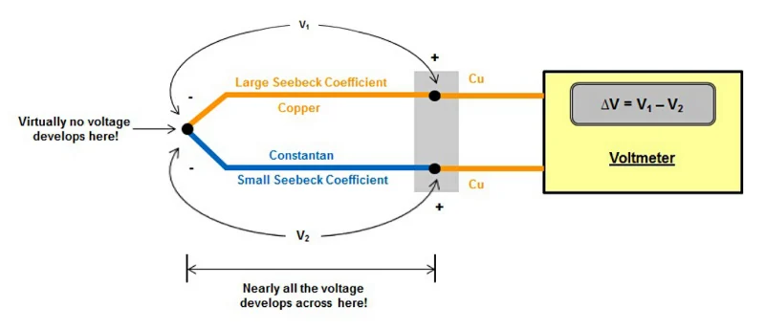
Data Acquisition – Basic Operation
Sensors
Temperature - Thermocouples
Measurement principle: Seeback effect
Description: temperature difference between two dissimilar electrical conductors or semiconductors produces a voltage difference between the two substances.
When heat is applied to one of the two conductors or semiconductors, heated electrons flow toward the cooler one.

Slide 34
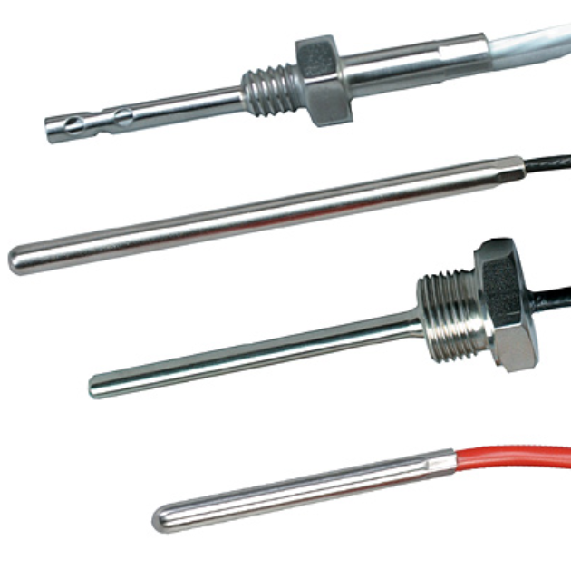
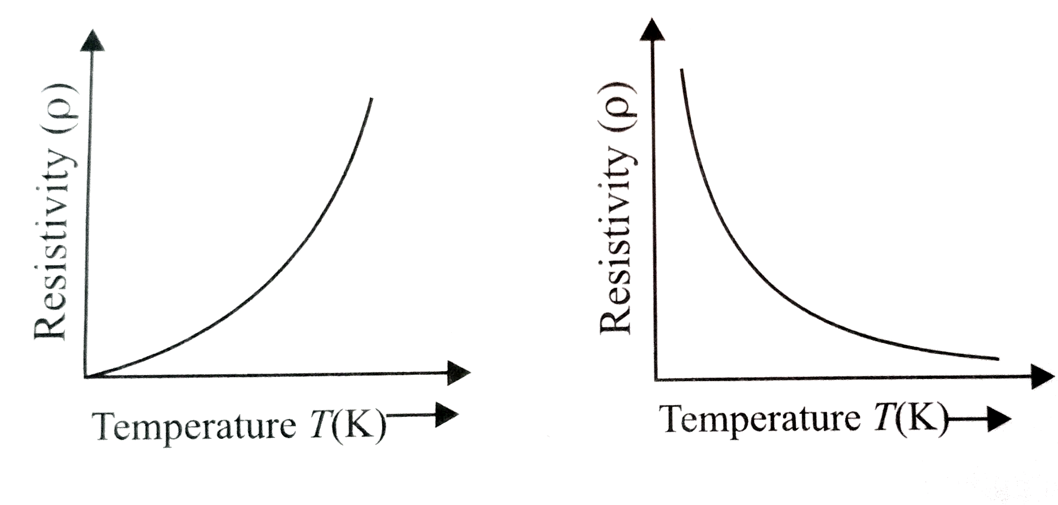
Data Acquisition – Basic Operation
Sensors
Temperature - Thermoresistors
Measurement principle: Resistivity variation
Description: in the case of metals or conductors, when the temperature increases, the resistivity of the metal increases as a result. Thus, the flow of current in the metal decreases (or increase).
The relation (ρ-T) has to be as much linear as possible

Slide 35
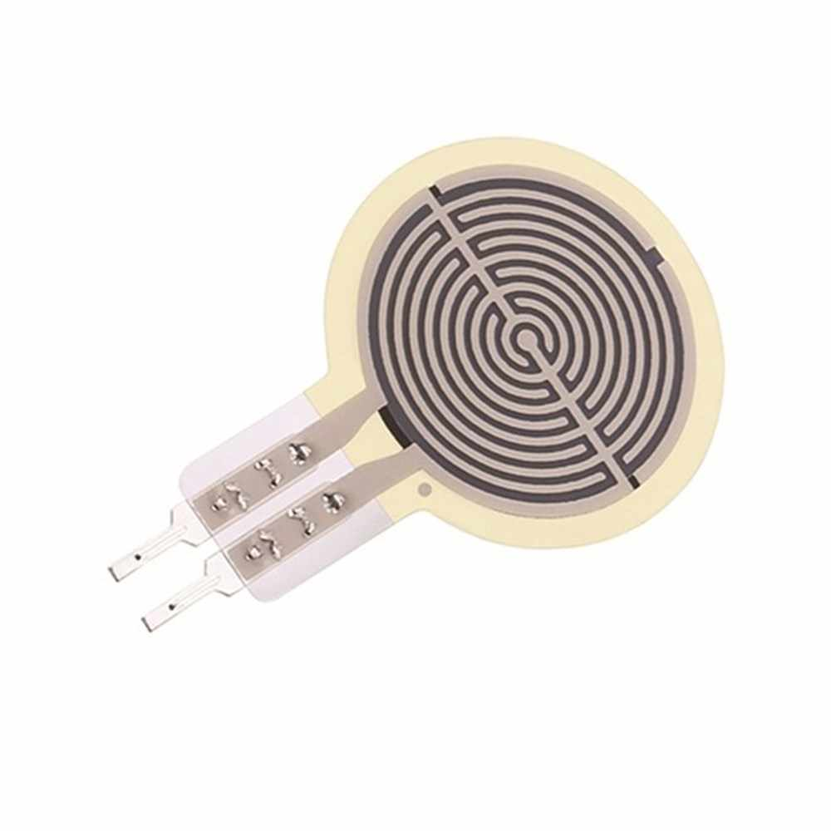
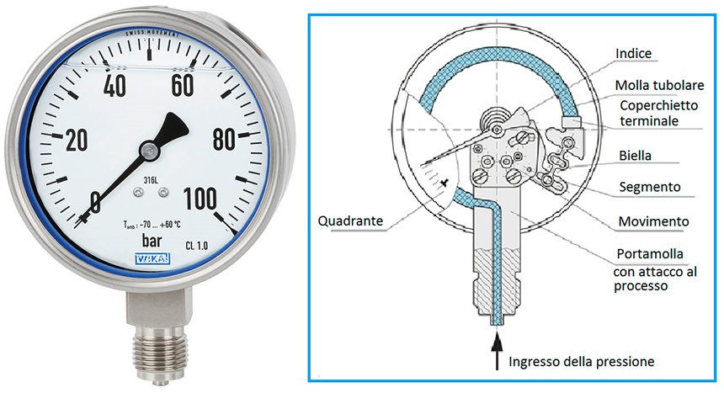
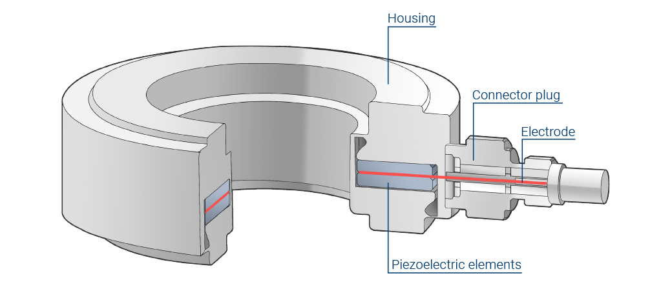
Data Acquisition – Basic Operation
Sensors
Pressure
  Mechanical Deflection
  Strain Gauges
  Piezoelectric

Slide 36
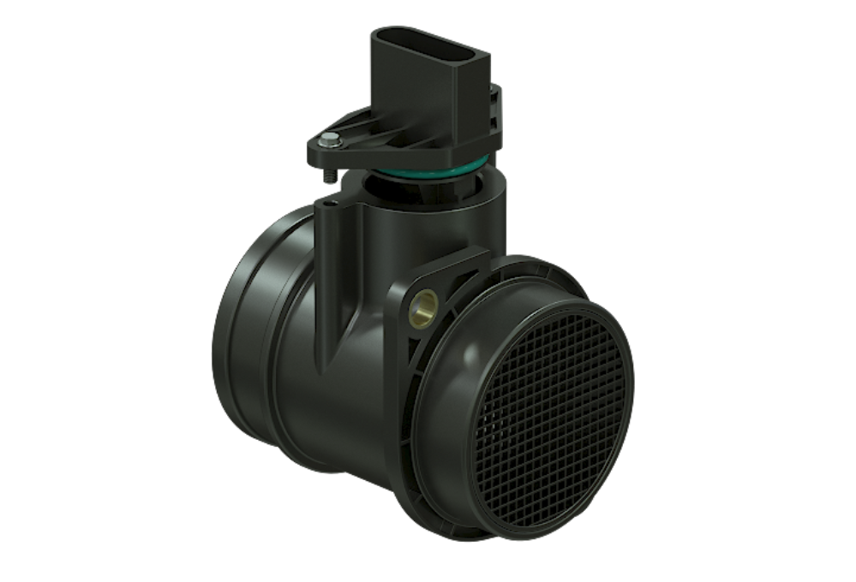
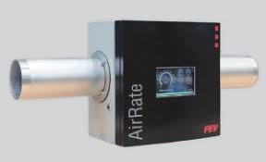
Data Acquisition – Basic Operation
Sensors
Air Flow Rate
  Mechanical
  Hot Wires
  Ultrasonic

Slide 37
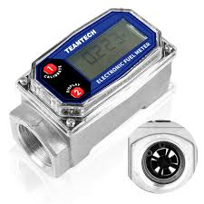
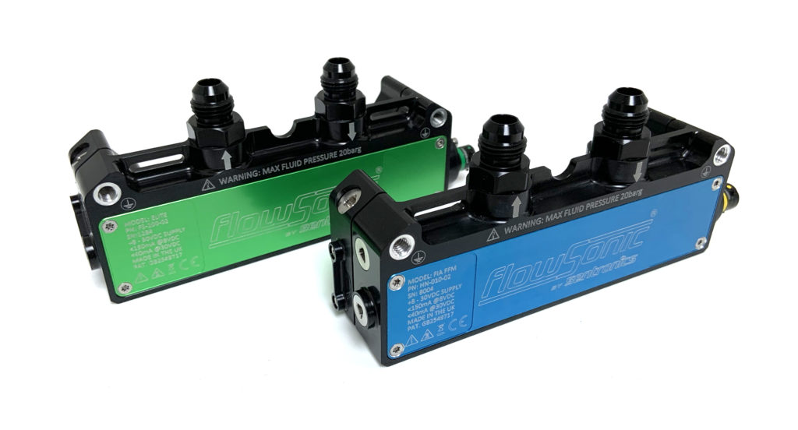
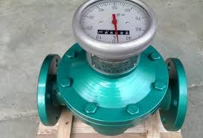
Data Acquisition – Basic Operation
Sensors
Fuel Flow Rate
  Mechanical (rotative / turbines)
  Coriolis
  Ultrasonic

Slide 38
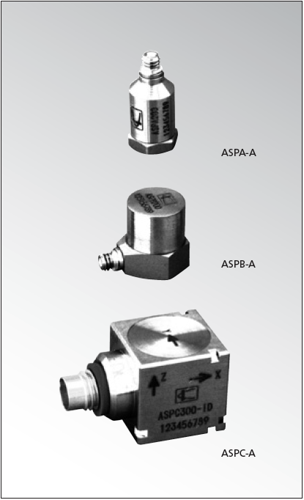
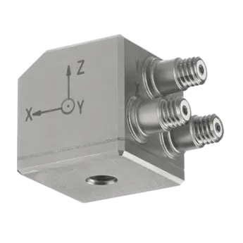
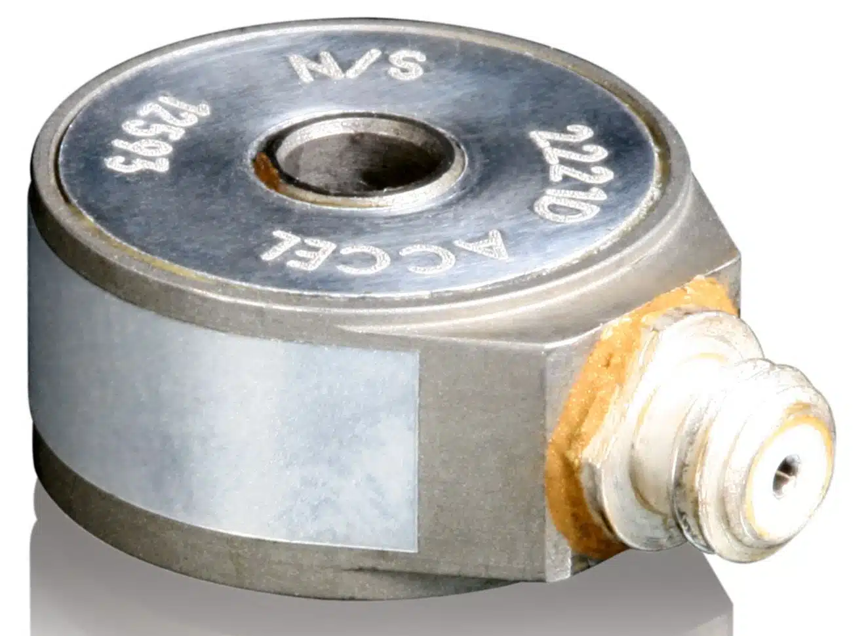
Data Acquisition – Basic Operation
Sensors
Vibration
  Piezoelectric Accelerometer

Slide 39
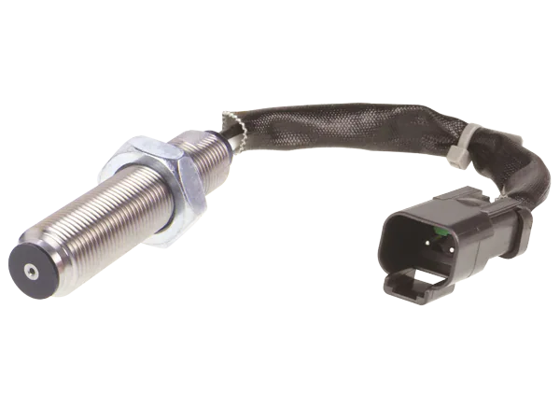
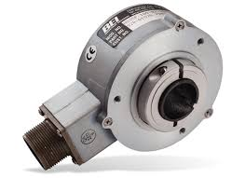
Data Acquisition – Basic Operation
Sensors
Speed
  VRS
  Optical encorder

Slide 40



Data Acquisition – Basic Operation
Sensors
Torque
  Torsiometer
  Load cell

Slide 41
Outline
Electronic Signals
Sensors
Actuators
Serial Communication protocols

Slide 42








Data Acquisition – Basic Operation
Actuator
An actuator, in simple terms, is used to actuate or change a physical state. Some examples are:
A light (such as an LED).
A motor.
A switch.

Slide 43

Data Acquisition – Basic Operation
Actuator
Actuators converts electric signals into e.g. radiant energy (light) or mechanical energy (movement).

Slide 44

Data Acquisition – Basic Operation
Actuator
How actuators are controlled really depends on what type of component we have. The most simple way is to simply turn something on/off, while more advanced is controlling the amount of voltage a component receives (i.e. the speed of a motor).

Slide 45


Data Acquisition – Basic Operation
Actuator
How actuators are controlled really depends on what type of component we have. The most simple way is to simply turn something on/off, while more advanced is controlling the amount of voltage a component receives (i.e. the speed of a motor).

Slide 46

Data Acquisition – Basic Operation
Sensor & Actuator
Sensors and actuators togheter are crucial for an accurate plant control and monitoring using closed-loop control strategies.

Slide 47
Outline
Electronic Signals
Sensors
Actuators
Serial Communication protocols

Slide 48

Data Acquisition – Basic Operation
Serial Communication protocols
There are several serial communication protocols that uses digital signals to send data. The most common are ModBus (RS232 – RS485), CAN, UART, SPI and I²C. These protocols are typically used to send data between host and remote devices, such as uploading a new program, or reading data directly from the remote sensor or actuator.

Slide 49

Data Acquisition – Basic Operation
Serial Communication protocols
There are several serial communication protocols that uses digital signals to send data. The most common are ModBus (RS232 – RS485), CAN, UART, SPI and I²C. These protocols are typically used to send data between host and remote devices, such as uploading a new program, or reading data directly from the remote sensor or actuator.

Slide 50


Data Acquisition – Basic Operation
Serial Communication protocols
The SPI and I²C protocols are used for communication between both internal and external components. The communication is handled by something called a serial bus, which is attached to a specific pin on the acquisition system.

Slide 51

Data Acquisition – Basic Operation
Serial Communication protocols
The serial protocols are used for communication between both internal and external components. The communication is handled by something called a serial bus, which is attached to a specific pin on the acquisition system (master).

Slide 52
Embedded Systems Introduction
Data Acquisition – Basic Operation
Department of Industrial Engineering (DIN) – viale del Risorgimento 2, Bologna (BO) Italy
Forlì, 26/09/2024
giacomo.silvagni2@unibo.it

